Slide 1
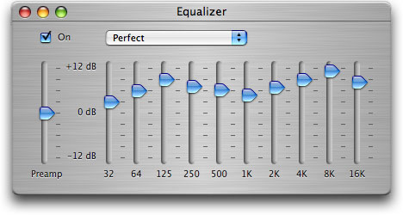
Filters and equalisers in JUCE

Slide 2
Equalisation
Definition
Boosting or cutting certain frequency components in a signal
Equalisation (EQ) is a form of filtering
Filters change magnitudes & phases of signal’s frequency content
Usually linear and time-invariant
Origin
Trying to obtain flat frequency response
No colouration
Example
Transmitting analogue voice signal over long distance
Transmission line attenuates high frequencies
Apply EQ to correct loss, resulting in more natural sound on other end
Notes:
Equalisation (EQ) is the process of boosting or cutting certain frequency components in a signal. The name originates from the application of trying to obtain a flat frequency response - no coloration. For example, when transmitting (analog) voice signals over long distances of wire, the high frequencies would be attenuated. By applying some equalisation filters, this loss could be 'undone' so that the voice would sound more natural on the receiving end. Equalisation is a very important tool in recording for bringing out an instrument's sound.

Slide 3

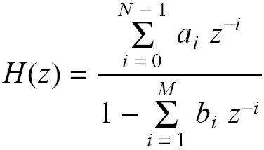
Digital filter can be described many different ways
Difference equation (time domain):
y[n] = a y[n -1] + x[n]
Transfer function (frequency domain):
Use normalised radial sampling frequency ω=2πf/f_{s}
z= e^{jω}
H(z)=Y(z) /X(z)=(1-az⁻¹)⁻¹
Block diagram
Algorithm (software)
General difference equation
Transfer function
If b_{i}=0, for all i,
No feedback
finite impulse response (FIR) filter
If b_{i}≠0, for any i,
Feedback
infinite impulse response (IIR) filter
y[n]
x[n]
+
a
z⁻¹
loop()
{
read x
y = a * y + x
write y
}

Slide 4
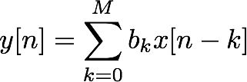
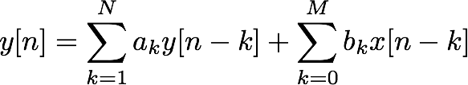


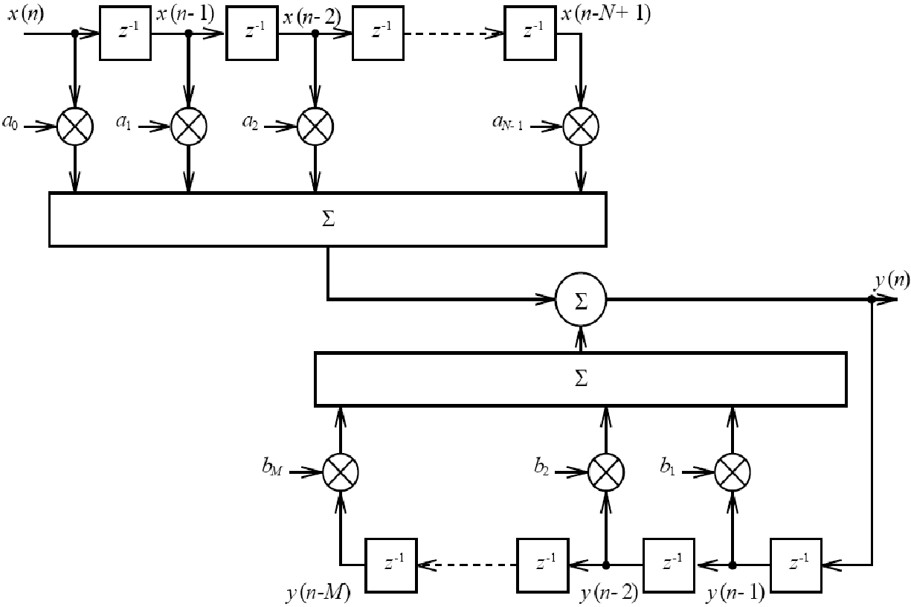
FIR & IIR filters
Weighted sum of last M inputs & N outputs
Infinite Impulse Response
Stability depends on coefficients ak
Weighted sum of last M inputs
Finite impulse response:
If , for n > M
Always stable
x[n]
z⁻¹
z⁻¹
z⁻¹
z⁻¹
z⁻¹
z⁻¹
...
b0
b1
b2
b3
b4
b5
b6
+
y[n]
Most equalisers use IIR filters

Slide 5
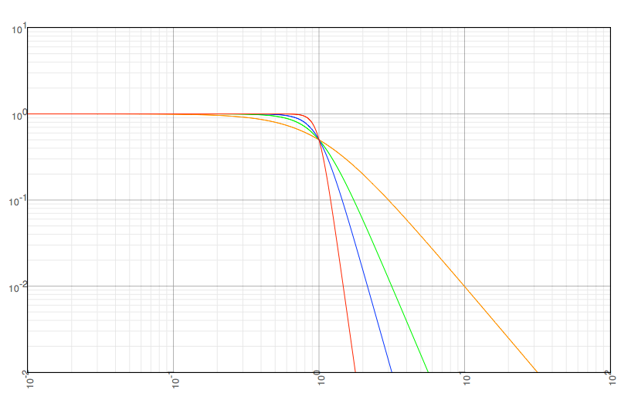
What do we want in a filter?
Generally two conflicting priorities:
Sharpness of cutoff
Between passband and stopband
Computational complexity
Measured in multiplies per sample
Butterworth
(IIR) filters
Order
N = 1
N = 2
N = 3
N = 6
log(H)
Rolloff:
6N dB/octave
log(f)

Slide 6



What do we want in a filter? (part 2)
For equalisers, sharpest cutoff not necessary
Small, controlled adjustments to frequency response
Advantages of IIR
More computationally efficient (lower orders)
Models analogue filters
Advantages of FIR
Always stable
Linear phase (when coefficients are symmetrical)
symmetrical impulse response means...
magnitude change with delay means...
phase is a linear function of frequency

Slide 7
High order filtering
For equalisation
Change some frequencies, but leave others unchanged
Combine multiple 1st and 2nd order filters
Series
Transfer function as product of 2nd order terms
Low shelf, high shelf and peaking filters
Parallel
Transfer function as sum of 2nd order terms
Low pass, high pass and bandpass filters
X(z)
H1(z)
H2(z)
H3(z)
Y(z)
H1(z)
X(z)
H2(z)
+
Y(z)
H3(z)

Slide 8
Ideal filters
Compare shelving to lowpass & highpass filters
Most filters remove low or high frequencies
Here, just want to boost or cut portion
|H|²
|H|²
1
Lowpass
Low Shelving Filter
G
1
0
ω_{c}
π
0
ω_{c}
π
Cutoff frequency
Where response changes between 2 levels
Highpass
|H|²
|H|²
High Shelving Filter
1
G
1
0
ω_{c}
π
0
ω_{c}
π

Slide 9
Ideal filters
|H|²
B
|H|²
B
1
Bandpass
G
Peaking Filter (boost)
1
ω_{c}
0
ω_{c}
π
0
π
Centre frequency
Where response reaches maximum or minimum
|H|²
B
Bandstop
|H|²
1
Peaking Filter (cut)
B
1
G
0
ω_{c}
π
0
ω_{c}
π

Slide 10
Magnitude response of shelving filters
varying gain (left) varying center frequency (right)
Boost
Cut
low shelving filter (top)
high shelving filter (bottom)
Boost
Cut

Slide 11
Magnitude responses for peaking filter
vary gain
vary center frequency
Boost
Cut
vary bandwidth
Warping changes where bandwidth occurs
ω_{c}=π/2 (half Nyquist rate) → bandwidth symmetrical about centre frequency
ω_{c} → 0: bandwidth to right of ω_{c} → low shelf
ω_{c} → π: bandwidth to left of ω_{c} → high shelf
Notes:
The filter's bandwidth BW is only perfectly centered around the center frequency F0 when such frequency is set to 0.5*pi (half the Nyquist rate). When F0 is closer to 0 or to pi, there is a warping effect that makes a larger portion of the bandwidth to occur at one side of the center frequency. In the edge cases, if the center frequency is set to 0 (pi), the entire bandwidth of the filter occurs to the right (left) of the center frequency. The result is a so-called shelving lowpass (highpass) filter.

Slide 12
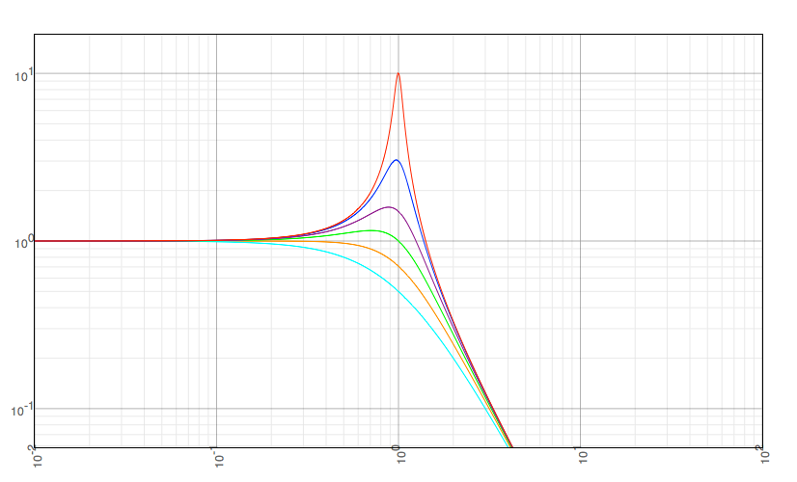
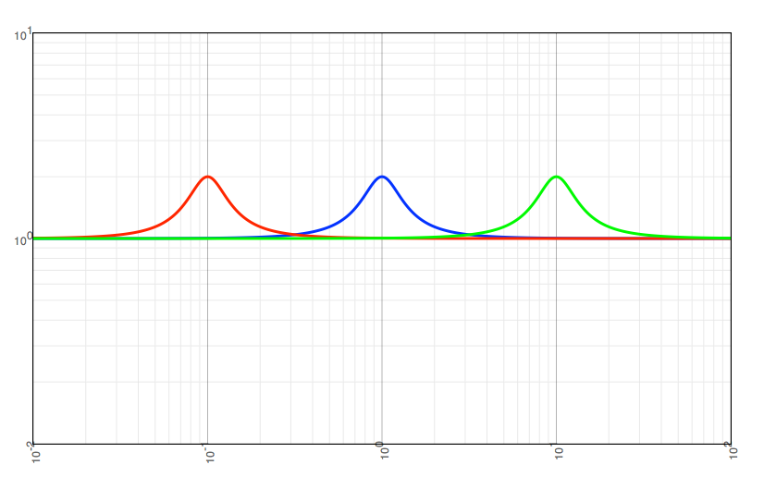
Q factor
Quality factor: ratio of centre frequency and bandwidth
Q=Centre frequency / bandwidth = ω_{c}/B
Constant Q peak filters
Tune centre frequency while keeping Q constant
Bandwidth scales with frequency
Second order
lowpass resonator filters
Q = 0.5
Q = 0.71
Q = 1
Q = 1.5
Q = 3
Q = 10
log-frequency scale
Notes:
One often used filter is the constant Q peak filter.
Q factor is defined as the bandwidth relative to cut-off frequency.
Q=ω_{c}/B
The cut-off frequency of peak filters is then tuned while keeping Q constant. So the bandwidth is increased when cut-off frequency increased and vice versa.

Slide 13
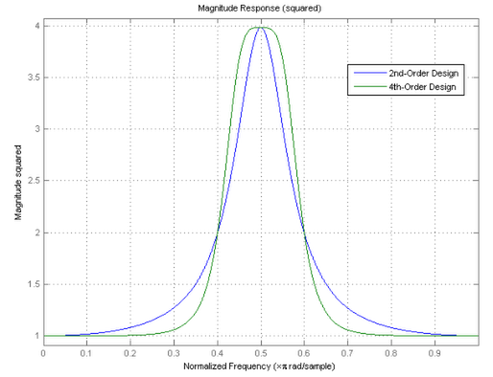
Effect of higher order
Sharper transition for 4th-order
Notes:
Some Basic Designs
One of the design parameters is the filter bandwidth, BW. You not only specify what the desired bandwidth is, you also specify at what gain this bandwidth is specified, GBW. In this case, we set GBW to be at half the peak magnitude squared gain of the filter, that is, approximately 3.0103 dB below the 6 dB gain. To see this, we can plot the magnitude squared and verify that the point at which the filter's bandwidth is 0.2*pi as specified is half of the peak magnitude squared.

Slide 14
Filter implementation
Consider this filter:
What do we need to calculate values in real time?
Suppose we had a function that took one new value of x[n] and returned one new value of y[n]
float a1, a2, b0, b1, b2; // Assume these are initialised
float calculate(float x) {
float y;
y =
return y;
}
float yPrev, yPrevPrev, xPrev, xPrevPrev; // Previous samples
[what goes here?]
b0*x + b1*xPrev + b2*xPrevPrev + a1*yPrev + a2*yPrevPrev;
b0*x + b1*xPrev + b2*xPrevPrev + a1*yPrev + a2*yPrevPrev;
yPrevPrev = yPrev; // Need to remember old values...
yPrev = y; // Could also use a circular buffer
xPrevPrev = xPrev;
xPrev = x;

Slide 15
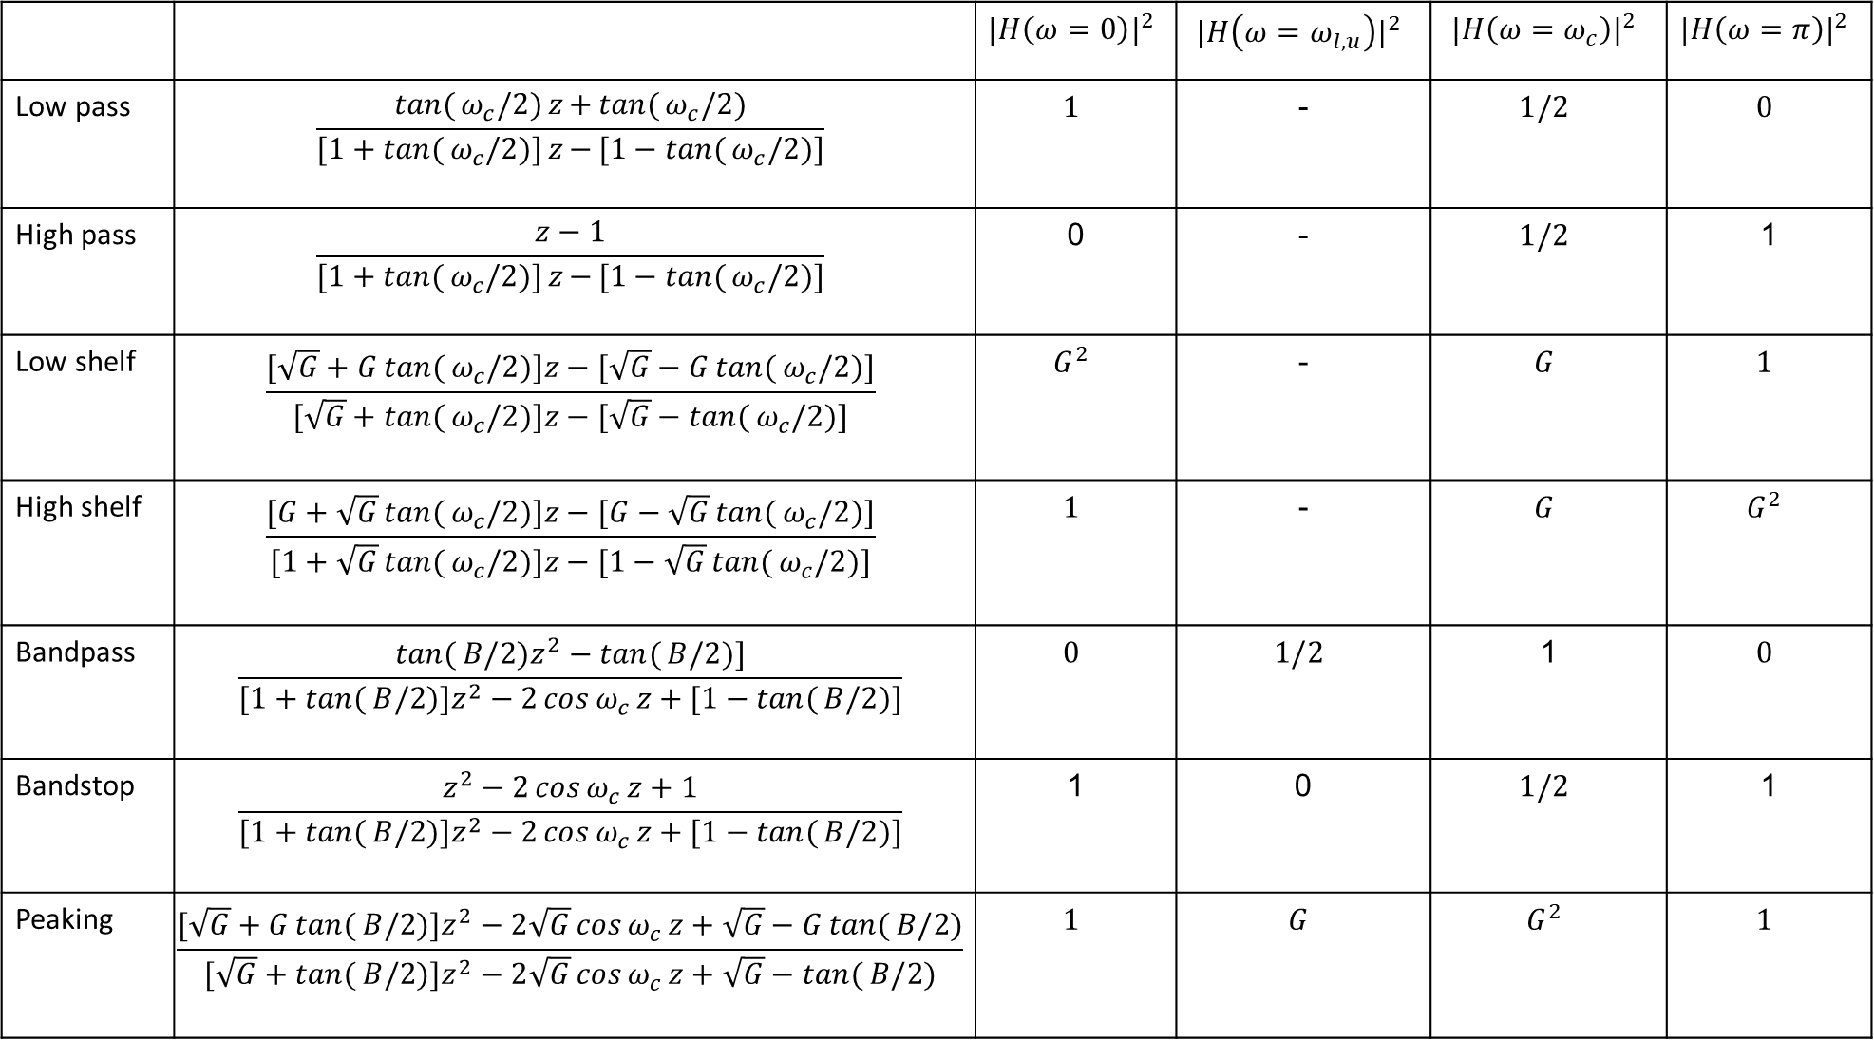
 |  | $${|H\left(ω=0\right)|}^{2}$$ | $${|H\left(ω=ω_{l,u}\right)|}^{2}$$ | $${|H\left(ω=ω_{c}\right)|}^{2}$$ | $${|H\left(ω=π\right)|}^{2}$$
Low pass | $$\frac{\tan{(}ω_{c}/2)z{+}\tan{(}ω_{c}/2)}{[1+\tan{(}ω_{c}/2)]z{−}[1−\tan{(}ω_{c}/2)]}$$ | $$1$$ | - | $$1/2$$ | $$0$$
High pass | $$\frac{z−1}{[1+\tan{(}ω_{c}/2)]z{−}[1−\tan{(}ω_{c}/2)]}$$ | 0 | - | $$1/2$$ | 1
Low shelf | $$\frac{[\sqrt{G}+G\tan{(}ω_{c}/2)]z−[\sqrt{G}−G\tan{(}ω_{c}/2)]}{[\sqrt{G}+\tan{(}ω_{c}/2)]z−[\sqrt{G}−\tan{(}ω_{c}/2)]}$$ | $$G^{2}$$ | - | $$G$$ | $$1$$
High shelf | $$\frac{[G+\sqrt{G}\tan{(}ω_{c}/2)]z−[G−\sqrt{G}\tan{(}ω_{c}/2)]}{[1+\sqrt{G}\tan{(}ω_{c}/2)]z−[1−\sqrt{G}\tan{(}ω_{c}/2)]}$$ | $$1$$ | - | $$G$$ | $$G^{2}$$
Bandpass | $$\frac{\tan{(}B/2)z^{2}−\tan{(}B/2)]}{[1+\tan{(}B/2)]z^{2}−2\cos{ω_{c}}z+[1−\tan{(}B/2)]}$$ | $$0$$ | $$1/2$$ | 1 | $$0$$
Bandstop | $$\frac{z^{2}−2\cos{ω_{c}}z+1}{[1+\tan{(}B/2)]z^{2}−2\cos{ω_{c}}z+[1−\tan{(}B/2)]}$$ | 1 | 0 | $$1/2$$ | 1
Peaking | $$\frac{[\sqrt{G}+G\tan{(}B/2)]z^{2}−2\sqrt{G}\cos{ω_{c}}z+\sqrt{G}−G\tan{(}B/2)}{[\sqrt{G}+\tan{(}B/2)]z^{2}−2\sqrt{G}\cos{ω_{c}}z+\sqrt{G}−\tan{(}B/2)}$$ | $$1$$ | $$G$$ | $$G^{2}$$ | $$1$$
Notes:
Two different formulations. The first is derived in my audio effects book, the second in the All About paper. Arithmetic mean between extreme square magnitudes, 0 and 1, used to find square magnitude at corner frequency in low/high pass, band pass/stop filters. (0+1)/2 = ½
Geometric mean between extreme square magnitudes, 1 and G, used to find square magnitude at corner frequency in low/high shelves, peaking filters. Sqrt(1 * G^2) = G

Slide 16
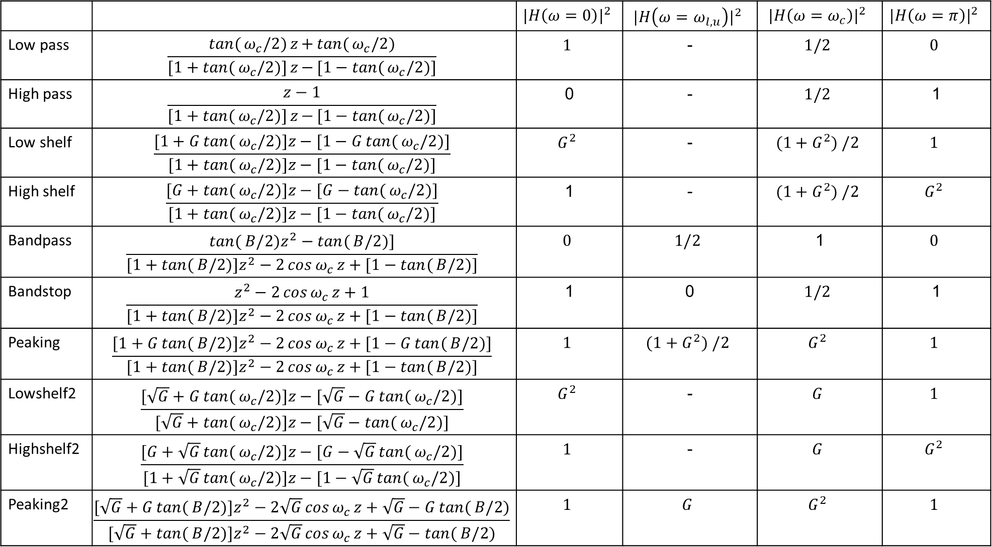
 |  | $${|H\left(ω=0\right)|}^{2}$$ | $${|H\left(ω=ω_{l,u}\right)|}^{2}$$ | $${|H\left(ω=ω_{c}\right)|}^{2}$$ | $${|H\left(ω=π\right)|}^{2}$$
Low pass | $$\frac{\tan{(}ω_{c}/2)z{+}\tan{(}ω_{c}/2)}{[1+\tan{(}ω_{c}/2)]z{−}[1−\tan{(}ω_{c}/2)]}$$ | $$1$$ | - | $$1/2$$ | $$0$$
High pass | $$\frac{z−1}{[1+\tan{(}ω_{c}/2)]z{−}[1−\tan{(}ω_{c}/2)]}$$ | 0 | - | $$1/2$$ | 1
Low shelf | $$\frac{[1+G\tan{(}ω_{c}/2)]z−[1−G\tan{(}ω_{c}/2)]}{[1+\tan{(}ω_{c}/2)]z−[1−\tan{(}ω_{c}/2)]}$$ | $$G^{2}$$ | - | $$(1+G^{2}) /2$$ | $$1$$
High shelf | $$\frac{[G+\tan{(}ω_{c}/2)]z−[G−\tan{(}ω_{c}/2)]}{[1+\tan{(}ω_{c}/2)]z−[1−\tan{(}ω_{c}/2)]}$$ | 1 | - | $$(1+G^{2}) /2$$ | $$G^{2}$$
Bandpass | $$\frac{\tan{(}B/2)z^{2}−\tan{(}B/2)]}{[1+\tan{(}B/2)]z^{2}−2\cos{ω_{c}}z+[1−\tan{(}B/2)]}$$ | $$0$$ | $$1/2$$ | 1 | $$0$$
Bandstop | $$\frac{z^{2}−2\cos{ω_{c}}z+1}{[1+\tan{(}B/2)]z^{2}−2\cos{ω_{c}}z+[1−\tan{(}B/2)]}$$ | 1 | 0 | $$1/2$$ | 1
Peaking | $$\frac{[1+G\tan{(}B/2)]z^{2}−2\cos{ω_{c}}z+[1−G\tan{(}B/2)]}{[1+\tan{(}B/2)]z^{2}−2\cos{ω_{c}}z+[1−\tan{(}B/2)]}$$ | $$1$$ | $$(1+G^{2}) /2$$ | $$G^{2}$$ | $$1$$
Lowshelf2 | $$\frac{[\sqrt{G}+G\tan{(}ω_{c}/2)]z−[\sqrt{G}−G\tan{(}ω_{c}/2)]}{[\sqrt{G}+\tan{(}ω_{c}/2)]z−[\sqrt{G}−\tan{(}ω_{c}/2)]}$$ | $$G^{2}$$ | - | $$G$$ | $$1$$
Highshelf2 | $$\frac{[G+\sqrt{G}\tan{(}ω_{c}/2)]z−[G−\sqrt{G}\tan{(}ω_{c}/2)]}{[1+\sqrt{G}\tan{(}ω_{c}/2)]z−[1−\sqrt{G}\tan{(}ω_{c}/2)]}$$ | $$1$$ | - | $$G$$ | $$G^{2}$$
Peaking2 | $$\frac{[\sqrt{G}+G\tan{(}B/2)]z^{2}−2\sqrt{G}\cos{ω_{c}}z+\sqrt{G}−G\tan{(}B/2)}{[\sqrt{G}+\tan{(}B/2)]z^{2}−2\sqrt{G}\cos{ω_{c}}z+\sqrt{G}−\tan{(}B/2)}$$ | $$1$$ | $$G$$ | $$G^{2}$$ | $$1$$
Notes:
Two different formulations. The first is derived in my audio effects book, the second in the All About paper.
sqrt(G) for gain at wc in shelving filters
First uses arithmetic meanSecond, square mag at fc is average of the other square mags, so (1+G^2)/2
Second uses geometric mean, square mag at fc is geo mean of the others, so sqrt(1*G^2)=G
Lowpass and highpass stay as is, probably same for bandpass and bandstop

Slide 17
JUCE DSP Classes for IIR filter processing
struct Coefficients (or ArrayCoefficients)
Set of coefficients for use in an Filter object
Member functions
makeFirstOrderLowPass
makeFirstOrderHighPass
makeFirstOrderAllPass
makeLowPass
makeHighPass
makeBandPass
makeNotch
makeAllPass
makeLowShelf
makeHighShelf
makePeakFilter
class Filter (or IIR filter)
Processing class that can perform IIR filtering on an audio signal
Member functions
process: Process a block of samples
processSample: process a single sample
…

Slide 18
Three ways to implement filters
Directly
keep recent inputs and recent outputs
Do this for every channel
Keep array of filter coefficients
Apply filter operation each sample, each channel
Use Juce IIRFilter class
implements generic 2 pole, 2 zero IIR filter
setCoefficients saves 6 coefficients to calculate output samples
processSamples performs filter operation on given samples
Use Juce IIRFilter and makePeakingFilter
Different programming environments implement filters differently
→ Lets use Juce classes

Slide 19
Direct implementation
for (int i = 0; i < numSamples; ++i) {
float out = coefficients[0] * channelData[i]
+ coefficients[1] * x1 + coefficients[2] * x2
- coefficients[4] * y1 - coefficients[5] * y2;
out = out / coefficients[3];
x2 = x1;
x1 = in;
y2 = y1;
y1 = out;
channelData[i] = out;
}

Slide 20
Define and initialise
Add private parameters to pluginProcessor.h
juce::AudioParameterFloat* gainParam;
juce::AudioParameterFloat* centreFrequencyParam;
juce::AudioParameterFloat* qParam;
juce::OwnedArray<juce::IIRFilter> filters;
Add audio parameters in constructor in pluginProcessor.cpp
addParameter(centreFrequencyParam = new juce::AudioParameterFloat
("cornerFrequency","Corner frequency",10.0f,20000.0f,1000.0f));
addParameter(gainParam = new juce::AudioParameterFloat
("gain","Gain",-40.0f,20.0f,0.0f));
addParameter(qParam = new juce::AudioParameterFloat("Q","Q",0.1f,20.0f,2.0f));
Add filters to array in prepareToPlay
filters.clear();
for (int i = 0; i < getTotalNumInputChannels(); ++i) {
juce::IIRFilter* filter;
filters.add(filter = new juce::IIRFilter());
}
Notes:
MidiKeyboardComponent needs a MidiKeyboardState and the orientation as arguments.

Slide 21
processBlock 1 - Define variables
Set up the basics in the processBlock method on pluginProcessor.cpp
juce::ScopedNoDenormals noDenormals;
auto numOutputChannels = getTotalNumOutputChannels();
auto numInputChannels = getTotalNumInputChannels();
auto numSamples = buffer.getNumSamples();
float gain = pow(10.0f, gainParam->get() / 20.0f);
float Q = qParam->get();
float centreFrequency = centreFrequencyParam->get();
float sampleRate = (float)juce::AudioProcessor::getSampleRate();
float normalisedFrequency = juce::MathConstants<float>::twoPi
* centreFrequency / sampleRate;
Notes:
must pass MidiKeyboardState object to initialise MidiKeyboardComponent object

Slide 22
processBlock 2, set coefficients
const float bandwidth = normalisedFrequency / Q;
const double two_cos_wc = -2.0*cos(normalisedFrequency);
const double tan_half_bw = tan(bandwidth / 2.0);
const double g_tan_half_bw = gain * tan_half_bw;
const double sqrt_g = sqrt(gain);
// takes arguments b0, b1, b2, a0, a1, a2. Normalises filter by a0 for time-domain implementations
auto coefficients = juce::IIRCoefficients(
sqrt_g + g_tan_half_bw, /* b0 */
sqrt_g * two_cos_wc, /* b1 */
sqrt_g - g_tan_half_bw, /* b2 */
sqrt_g + tan_half_bw, /* a0 */
sqrt_g * two_cos_wc, /* a1 */
sqrt_g - tan_half_bw /* a2 */
);
for (int i = 0; i < filters.size(); i++)
filters[i]->setCoefficients(coefficients);

Slide 23
processBlock 3, apply filters
for (int channel = 0; channel < numInputChannels; ++channel) {
float* channelData = buffer.getWritePointer(channel);
filters[channel]->processSamples(channelData, numSamples);
}
Not optimal, not elegant
Recalculates filters every block
Should only recalculate when parameters change
Only does peaking filters
Doesn’t do chain of filters, yet
filters1[channel]->processSamples(channelData, numSamples);
filters2[channel]->processSamples(channelData, numSamples);

